Slide 1
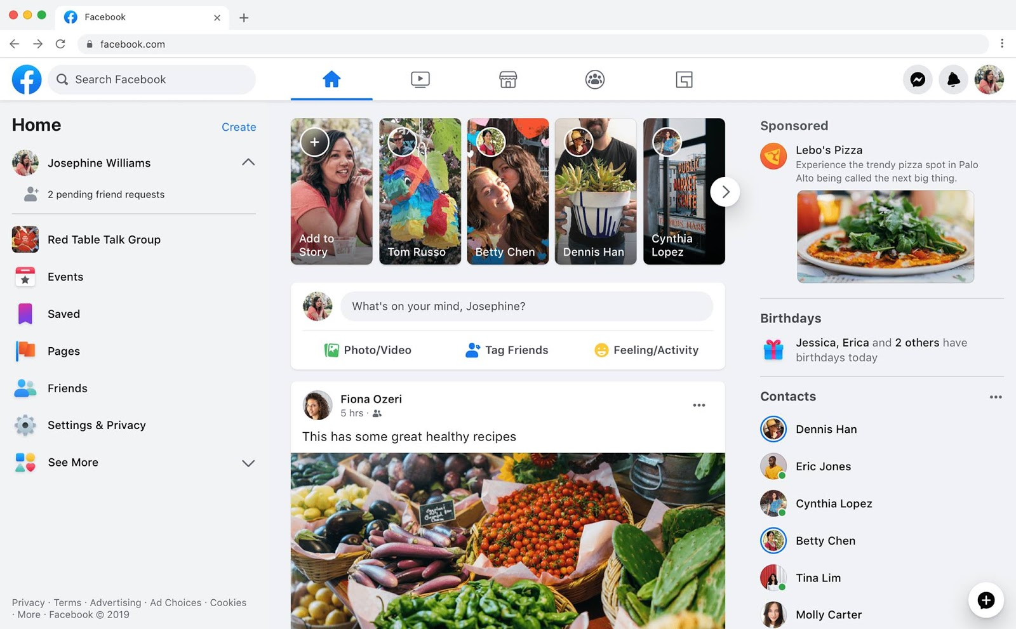
Identify root components of website below

Slide 2
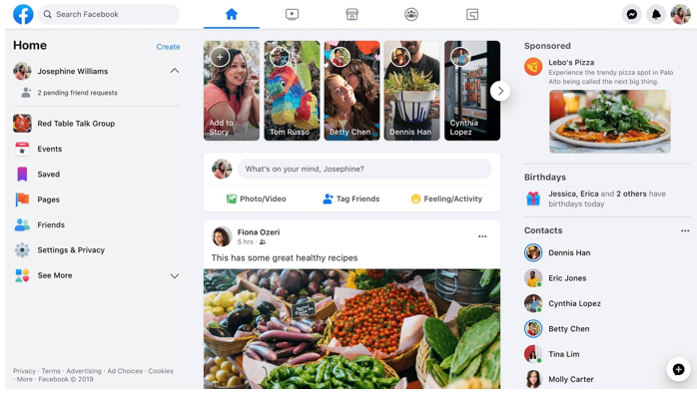
Identify for the root
Nav
Main

Slide 3
Identify for the Nav
Nav-left
Nav-center
Nav-right

Slide 4


Identify for the Nav-left
image
icon
text
Input
Identify for the Nav-center
icon
icon
icon
icon
icon

Slide 5

Identify for the Nav-right
icon
icon
icon

Slide 6
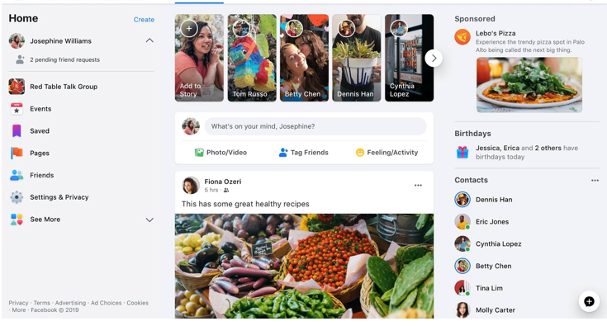
Identify for the Main
Main-left
Main-center
Main-right

Slide 7
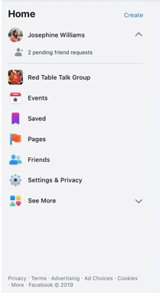
Identify for the Main-left
Main-header
Main-body
Main-footer

Slide 8


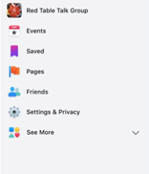
Identify for the Main-left
Main-header
text
text
Main-body
text
icon
Main-footer
icon
text
icon
text
icon
text
icon
text
icon
text
icon
text
icon
text

Slide 9
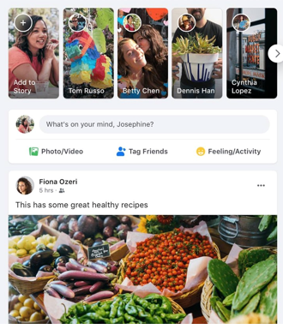
Identify for the Main-center
Main-header
Main-body
Main-footer

Slide 10
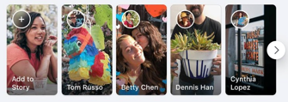

Identify for the Main-center
Main-header
card
card
card
card
card
Identify for the card
icon
text

Slide 11


Identify for the Main-center
Main-body
icon
botton
Main-body1
icon
text
icon
text
icon
text
Main-body2
Main-footer
icon
text
icon
Main-footer1
text
Main-footer2
image

Slide 12
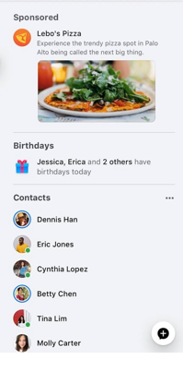
Identify for the Main-right
Main-right
mainright-1
mainright-2
mainright-3

Slide 13


Identify for the Main-right
mainright-1
mainright-1
text
image
image
mainright-2
mainright-2
text
icon

Slide 14
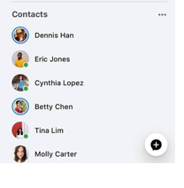
Identify for the Main-right
mainright-3
text
icon
Top-side
icon
text
icon
text
icon
text
icon
text
icon
text
icon
text

